Slide 1

Rhodes Forum
12th Annual Session
September 25-29, 2014
Alexander Neklessa
.
Cartography of the New World Complex
Discourse and Visual Presentation
© 2014, Александр Неклесса
© 2014, SYNLA Project

Slide 2
Preadaptation
CARTOGRAPHY OF CHANCHES
Future
Forthcoming
Planning horizon
Conflict
of goals
RISK LEVEL
ACTION

Slide 3
GENOME of HISTORY
Dynamics of basic strategic resources
Human
Complementary strategic resources
Complementary strategic resources
culture
Creativity
ecology
Information
connections
time
Industry
transport
Energy
Commodities
technic
money
Phyzical power
salvage
Natural resourCes
Cattle Breeding
Nature
Agriculture

Slide 4
AIM’S DEVIATIONS
Variability of strategic aims
Humanity
Creativity
Technology
Civilization
Deconstruction
Industry
Abstraction
Salvage
Finances
Criminal
Information
Commodity
Physical power
Nature

Slide 5
Transit*
PRESENT SITUATION (strategic crossroad)
Creative society
Deconstruction
Industrial world
Digital universe
Involution

Slide 6
COMPLEX WORLD
EFFECTIVE SUBGECTS OF INTER-GLOBAL RELATIONS (MATRIX)
CORPORATIONS
Complex world system
Nation-StateS
GEOCON
CLOUDY ASSOSIATIONS

Slide 7
World regulators
Nation-state
System-states
(integrities)
Subsidiaries

Slide 8
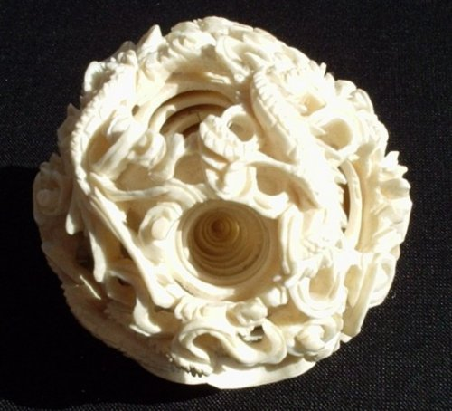
Geocon
(political-economic universe)
Staff-economy (New North/Globe)
Technologies (West)
Industrial production (East)
Raw Materials (South)
Other (Hyper-North)
Deconstruction (Deep South)

Slide 9
PAX OECONOMICANA (via Moscow meridian)
GYPER-
NORTH
NEW NORTH
  NEW EAST
RF
WEST
DEEP SOUTH
SOUTH

Slide 10
Corporation-state
TNC
(trans-natioal/trans-border corporatios)
Corporation
Associations + complex interaction

Slide 11
GLOCALIZATION
(MUNICIPAL RECONFIGURATION OF CIVILIZATION)
The cross-border urban universe(meta-polis)
Nexus
Hub
Node
Advanced
Upstarter
Terminal’s hierarchy ( e.g. rating of innovative cities*)
*2thinknow Innovation Centre Cities Global Index 2012

Slide 12
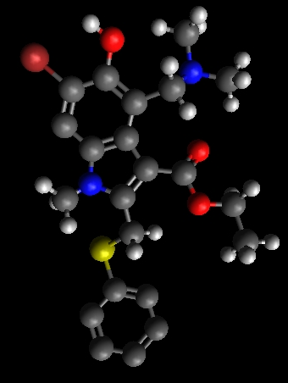
Cloudy associations

Slide 13
5 methodological revolutions
Appendix I
Non-classic operator
Self-organized criticality
System Dynamics
System analysis
Operations research

Slide 14
Management in complex environment
Appendix II
Synergy / Serendipity / Synchronicity
Semantic (reflex) management
Dot-point (acupunctural) management
Reflexive (pro-subject) management
Matrix (complex, scenario) management
Reduction of complexity

Slide 15

P.S. Перевод слайдов презентации на английский язык будет выслан позднее
Any questions?
http://www.intelros.ru/

